Slide 1


Land surface Interactions with the Atmosphere
over the IberianSemi-arid Environment (LIAISE):
1st modelling intercomparison
M.A. Jiménez¹, J. Cuxart¹, A. Grau¹,
(1) Universitat de les Illes Balears, Palma, Spain
A. Boone², S. Donier², P. Le Moigne²,
(2) CNRM, Meteo-France/CNRS, Toulouse, France
J.R. Miró³, Jordi More³,
(3) Servei Meteorològic de Catalunya, Barcelona, Spain
A. Tiesi⁴, P. Malguzzi⁴,
(4) CNR-ISAC, Bologna, Italy
J. Brooke⁵ and Martin Best⁵
(5) Met Office, Exeter, UK

Slide 2
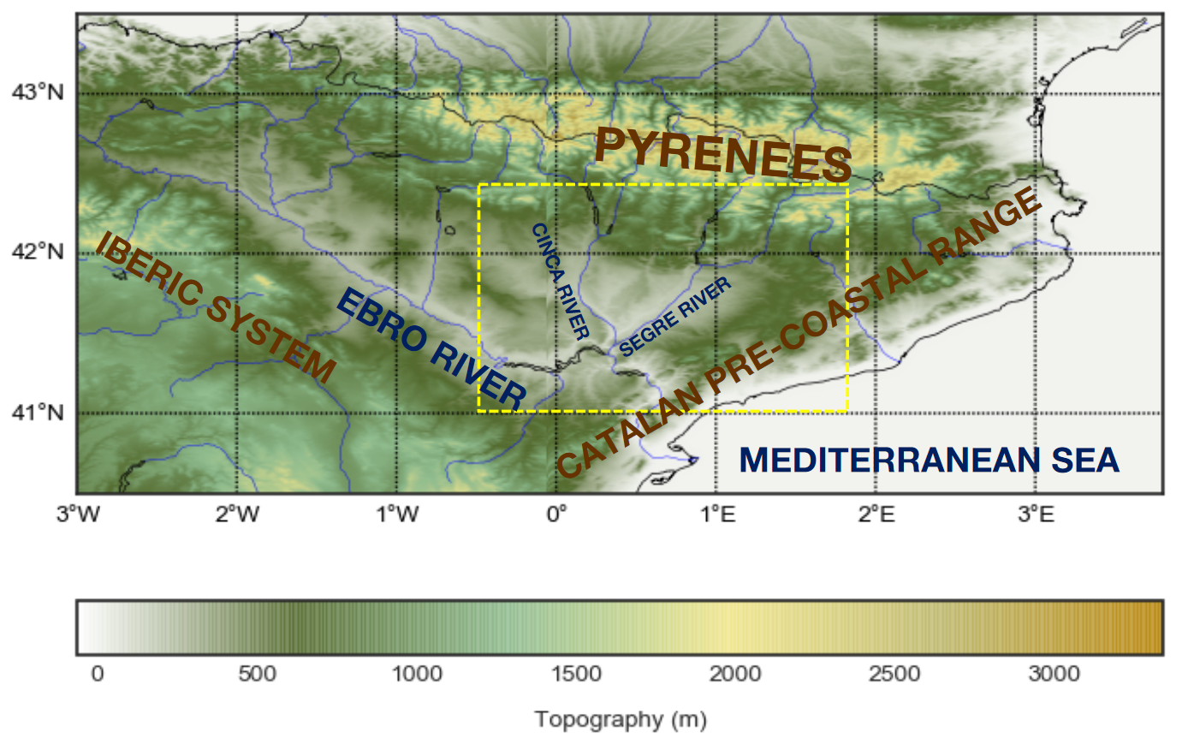
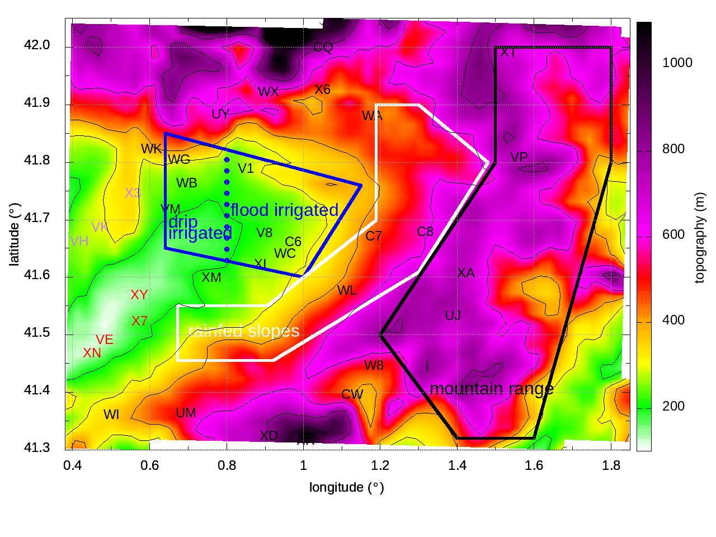
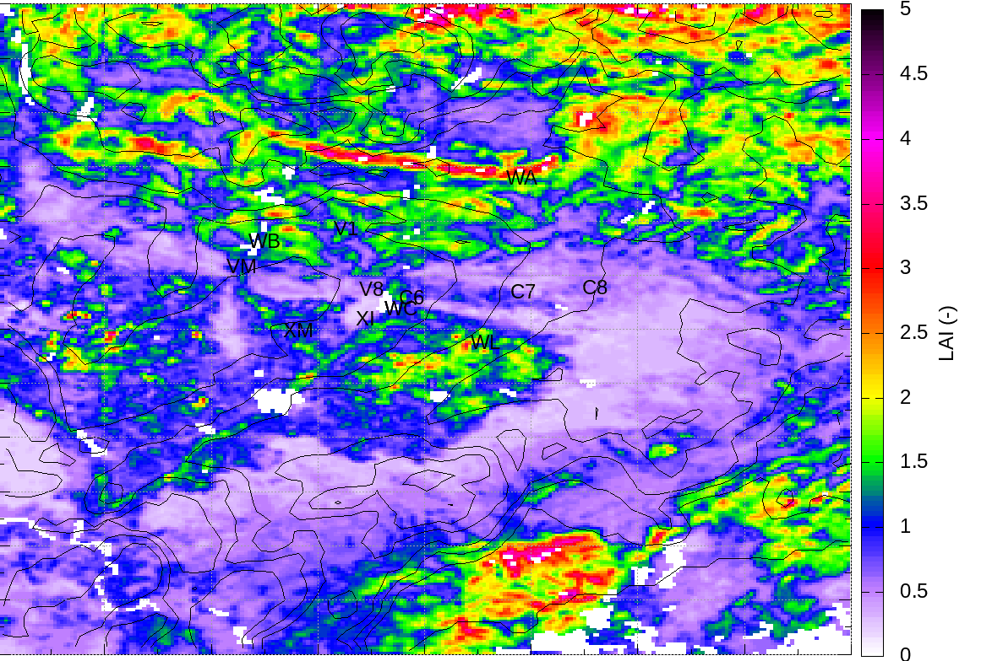
Eastern Ebro Subbasin
Complex terrain
Topography
Soil uses
Heterogeneities
(circulations)
Local, basin, meso-synop
(Grau et al., 2021, JAMC)
LAI-MODIS (July 2016)

Slide 3
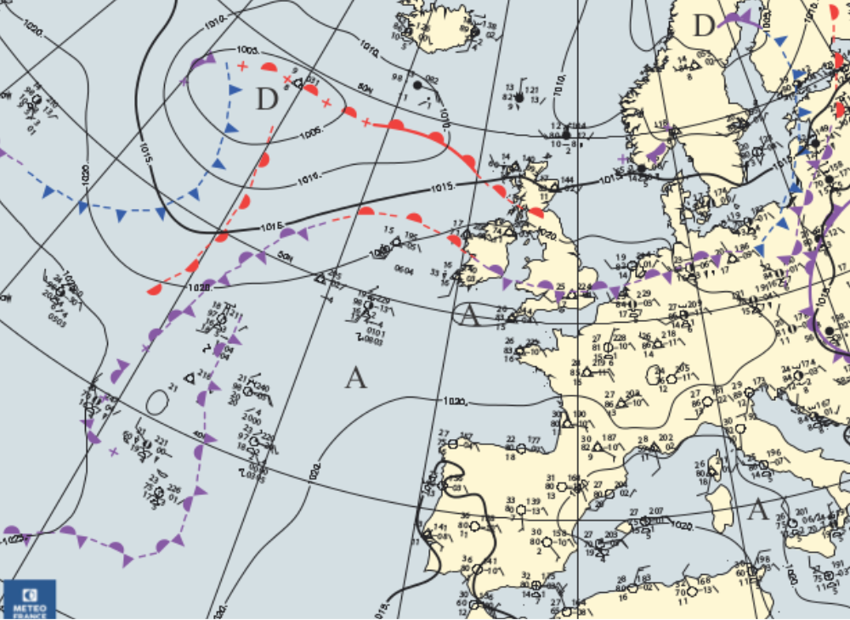
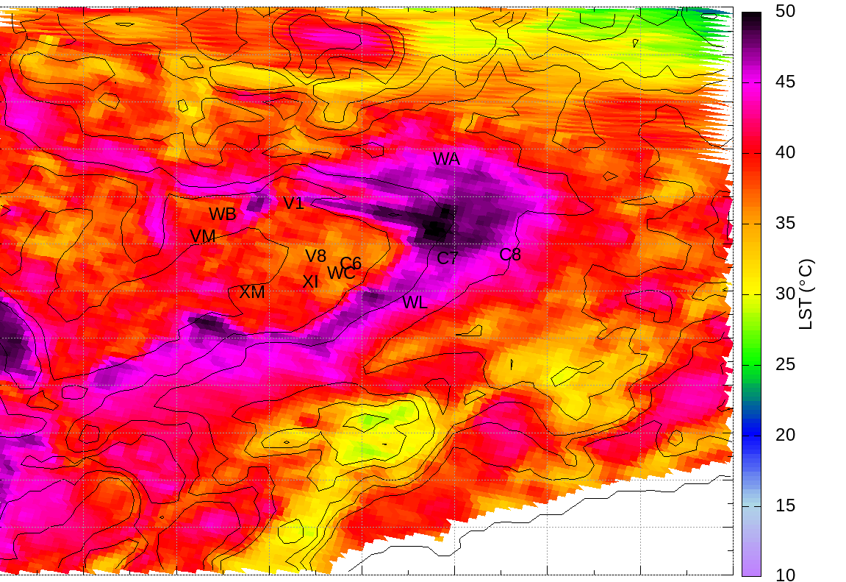
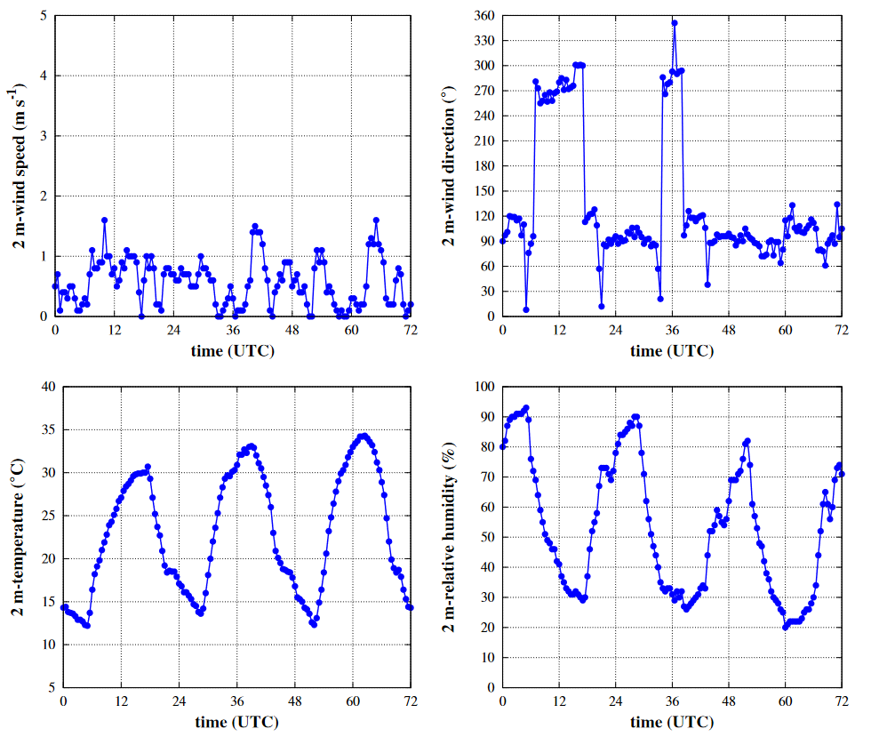
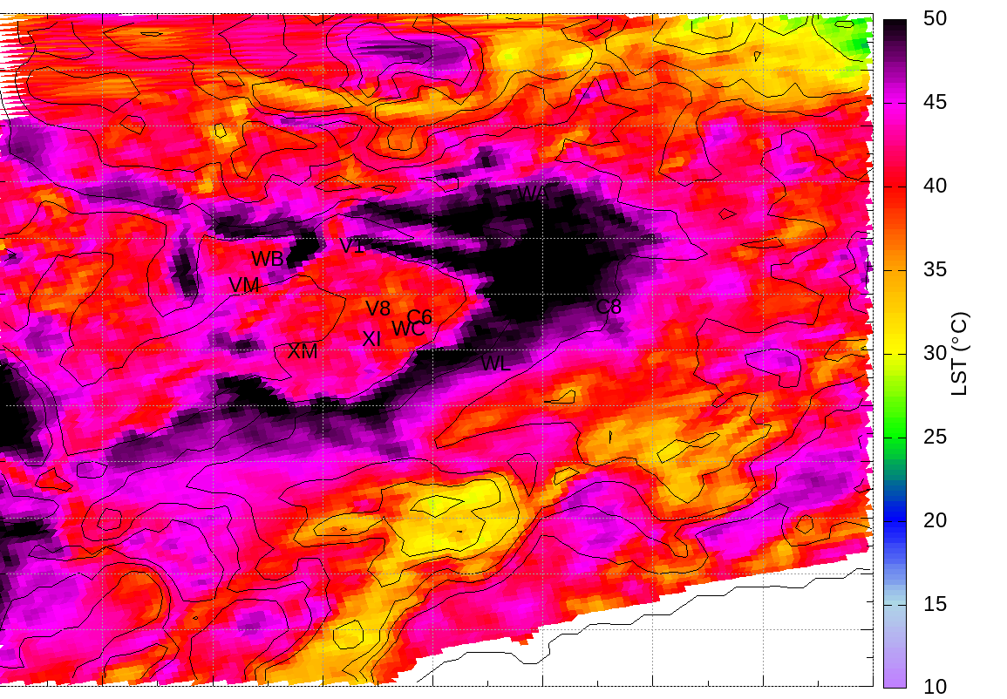
The 1st mesoscale
intercomparison case
17th July 2016 at 1200 UTC
17th July 2016 at 1110 UTC
2m-wind speed
2m-wind direction
MODIS
17th July 2016 at 1250 UTC
El Poal (V8)
2m-temperature
2m-relative humidity
MODIS

Slide 4
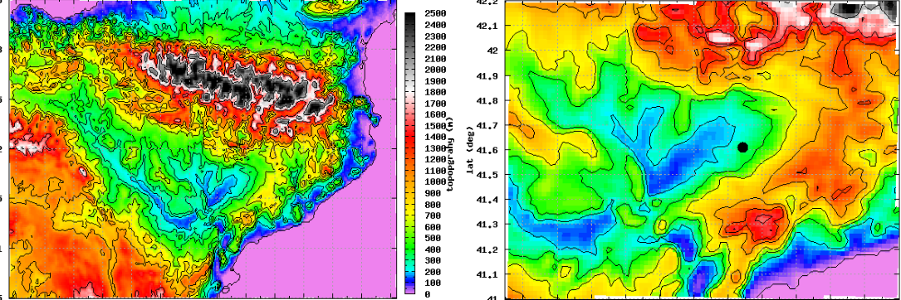
The 1st mesoscale intercomparison case
Models
MesoNH (MNH)
MOLOCH (MOL)
Unified Model (UM)
WRF
16-18 July 2016
* clear skies, A conditions
* thermal heterogeneities
* locally/basin/mesoscale generated
winds (interact)
outer
domain
inner
domain
Model setup
36h run (from 16 July at 1800 UTC to 18 July at 0600UTC)
2 nested domains (1-way): 2km and 400m resolution
Vertical resolution (2m and stretched above, 85 levels)
Initial/Lateral BC: ECMWF
Differences: Turbulence, Radiation (5min), Surface

Slide 5
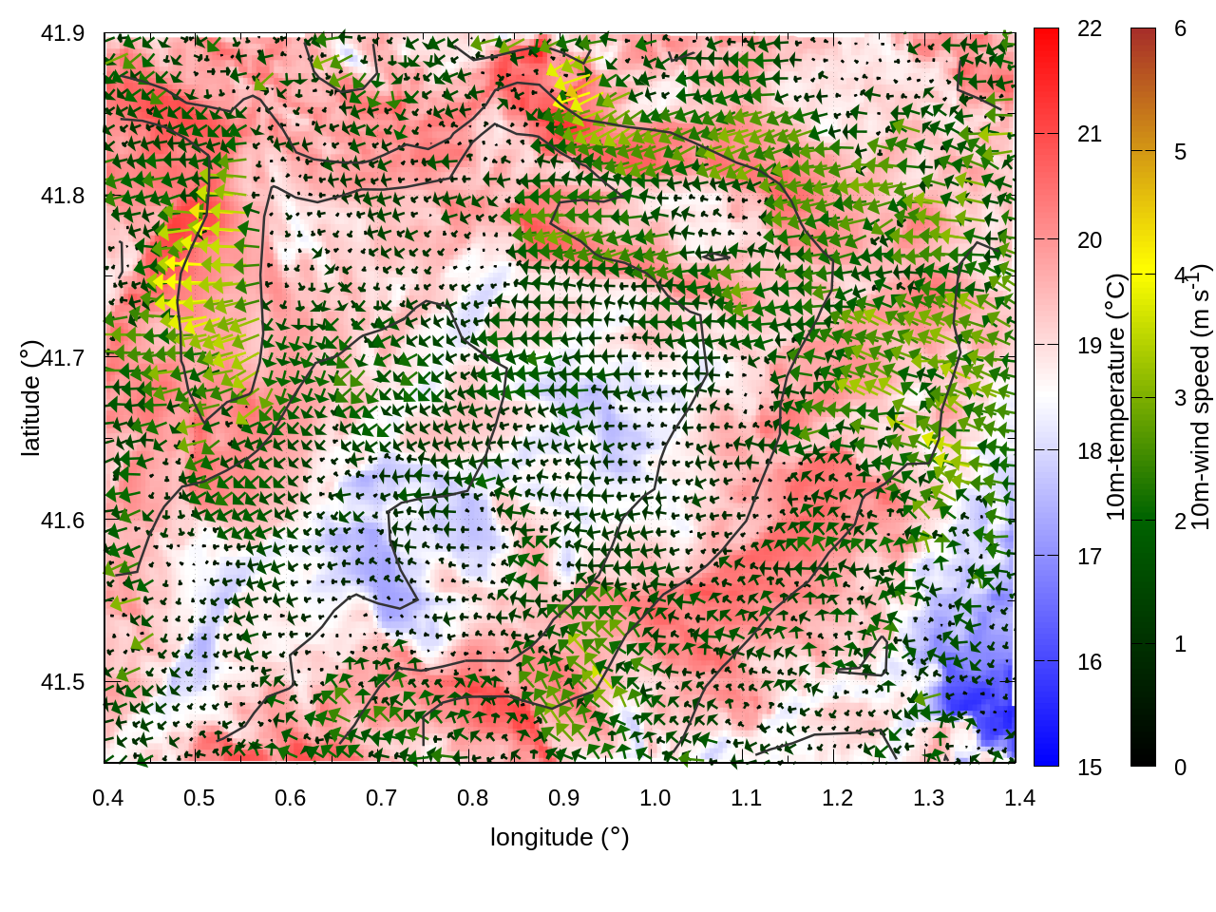
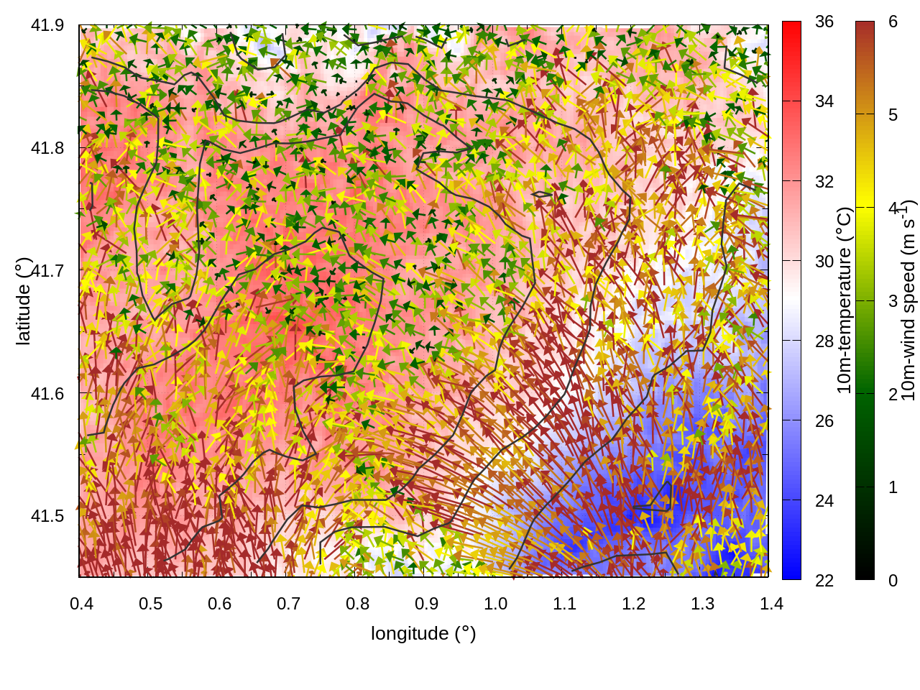
10 m (agl)
wind vectors
(MesoNH)
17th July
0600 UTC
E-wind prevail
17th July
1500 UTC
SB front
interacts with
local winds

Slide 6
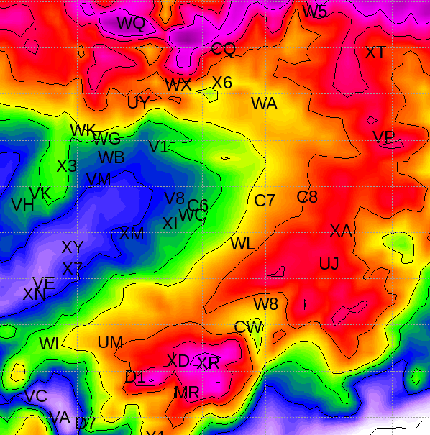
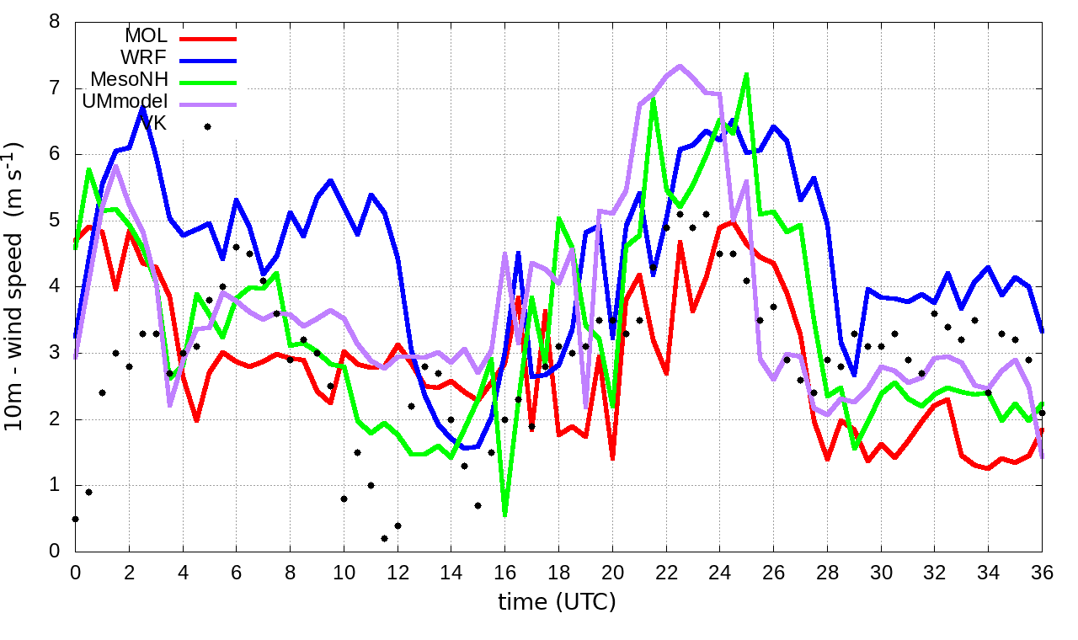
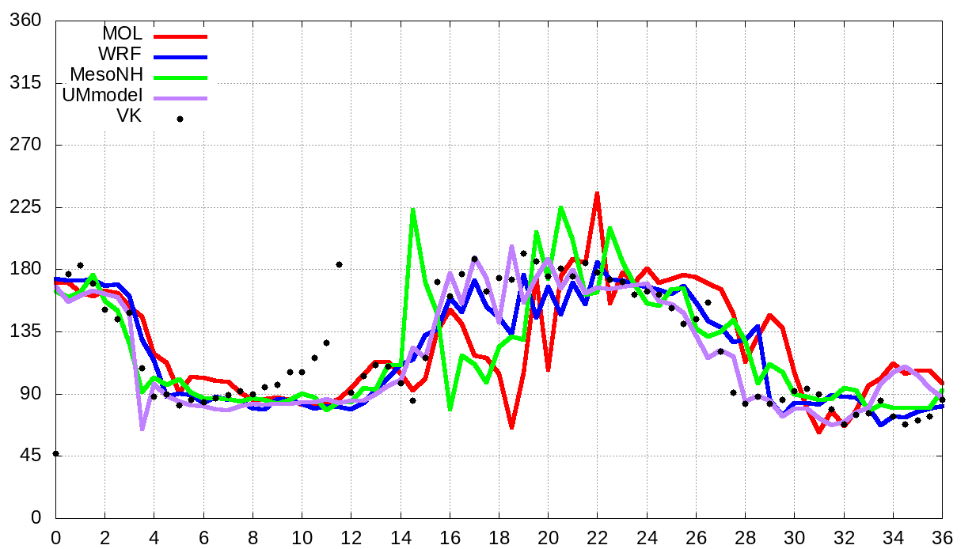
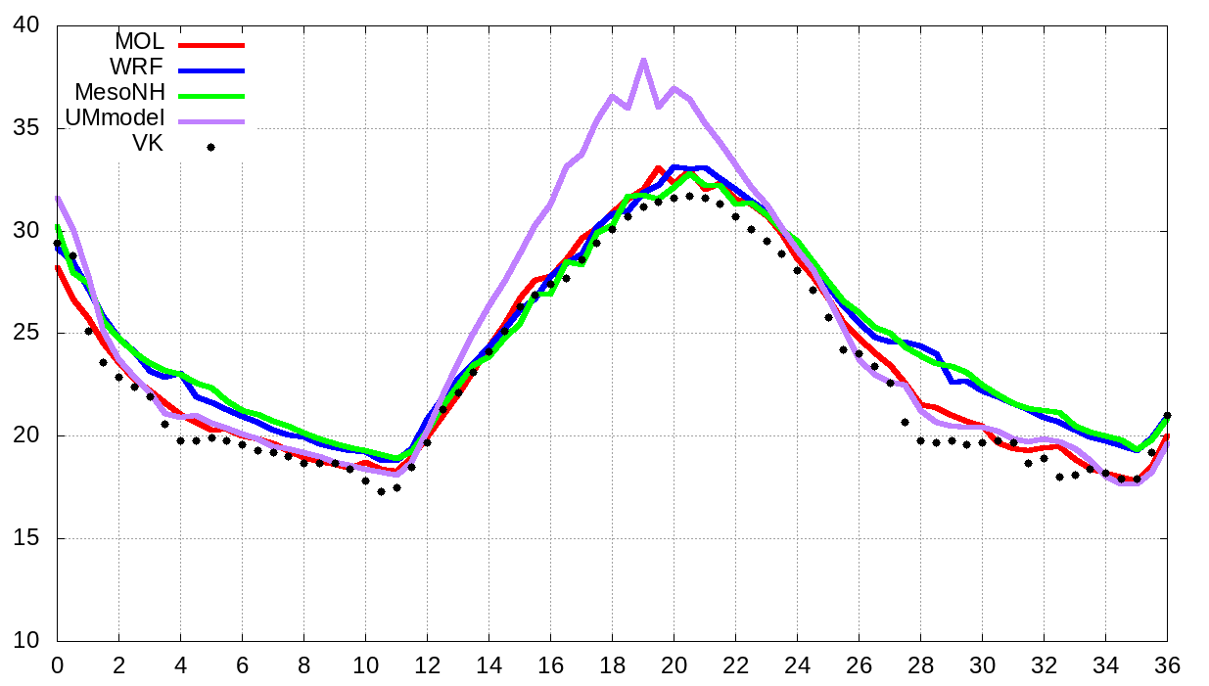
Validation using AWS
Moloch WRF MesoNH UM
10m-wind speed
Raïmat (VK) - WEST
10m-wind direction
2m-temperature
Time (hours since 1800 UTC)
Time (hours since 1800 UTC)

Slide 7
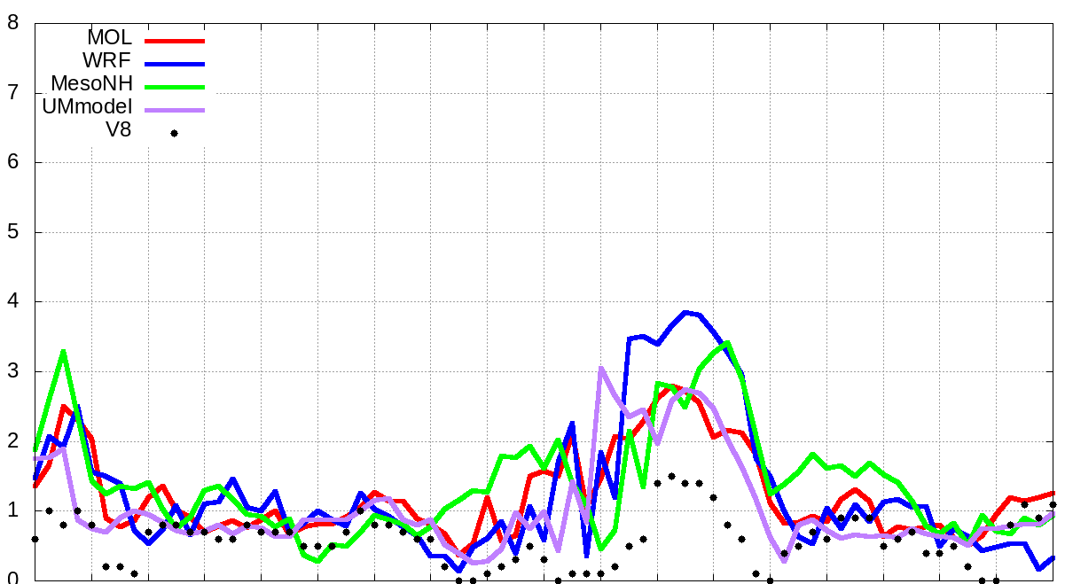
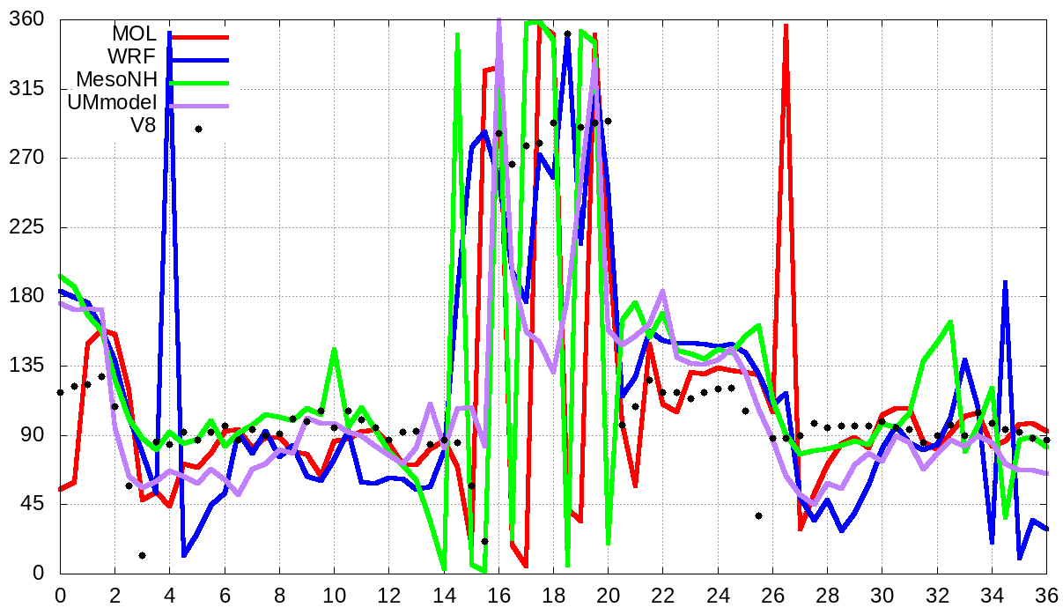
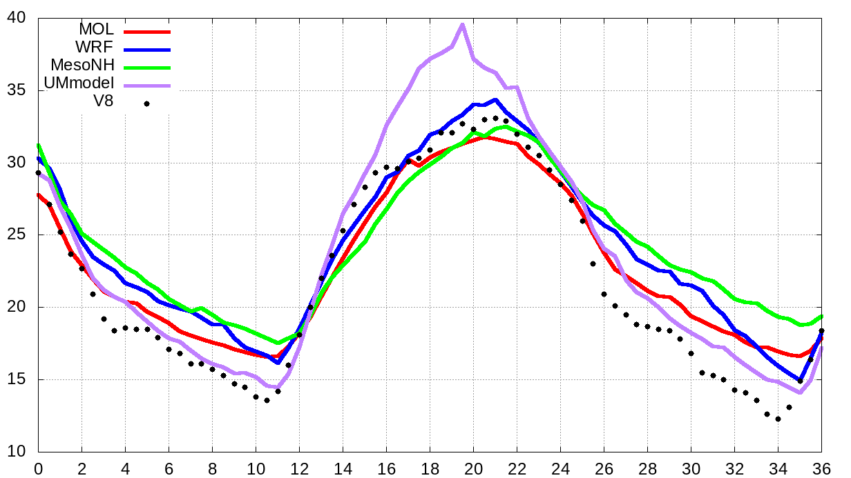
Validation using AWS
Moloch WRF MesoNH UM
10m-wind speed
10m-wind
direction
El Poal (V8) - FLOOD
2m-temperature
Time (hours since 1800 UTC)
Time (hours since 1800 UTC)

Slide 8
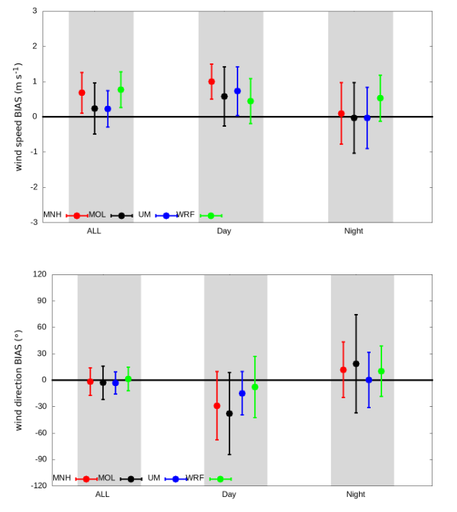
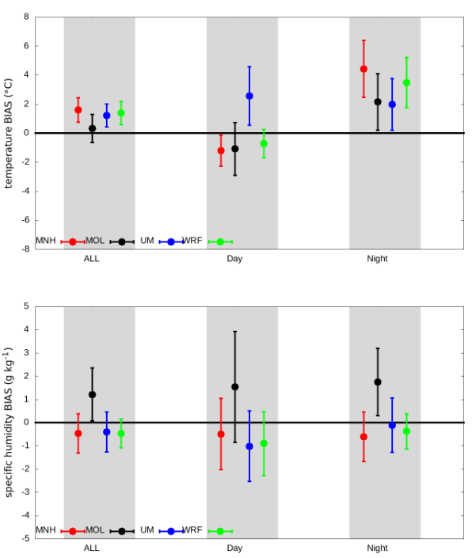
Validation using AWS
Mean BIAS (model-obs)
ALL run,
DAY (1000-1400 UTC), NIGHT (0000-0400 UTC)
MesoNH
Moloch
UM
WRF
Wind speed: about +0.5m/s
Temperature: about +1.5ºC
ALL DAY NIGHT
ALL DAY NIGHT
Wind direction: [-60º,+30º]
Specific humidity: about -1g/kg
ALL DAY NIGHT
ALL DAY NIGHT

Slide 9
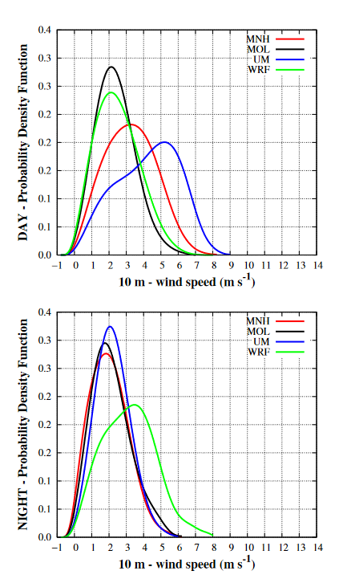
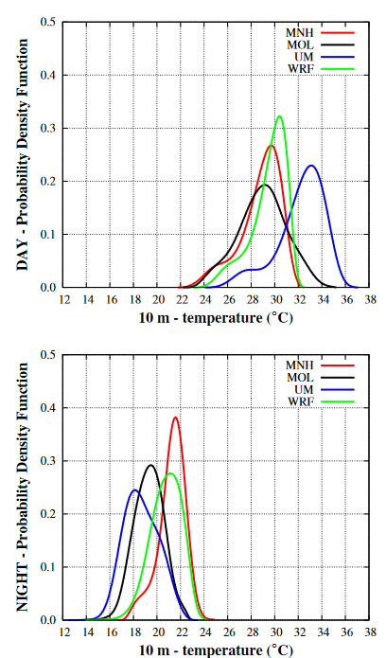
heterogeneity of the fields
1200 UTC
1200 UTC
0200 UTC
0200 UTC

Slide 10
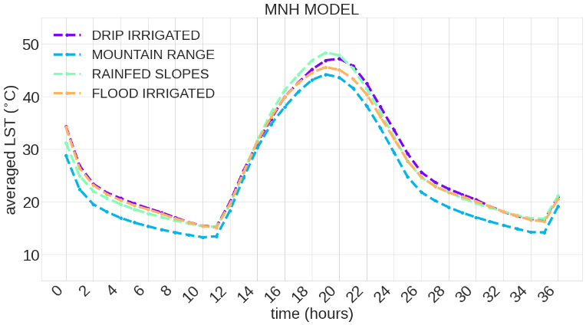
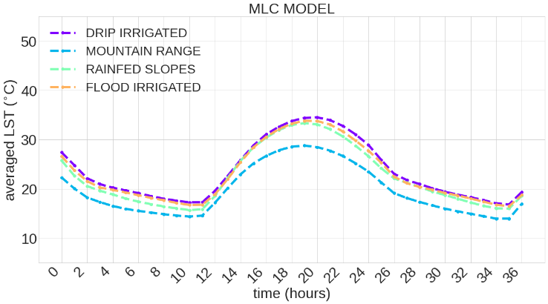
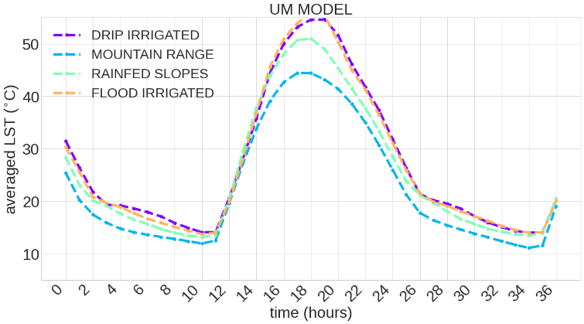
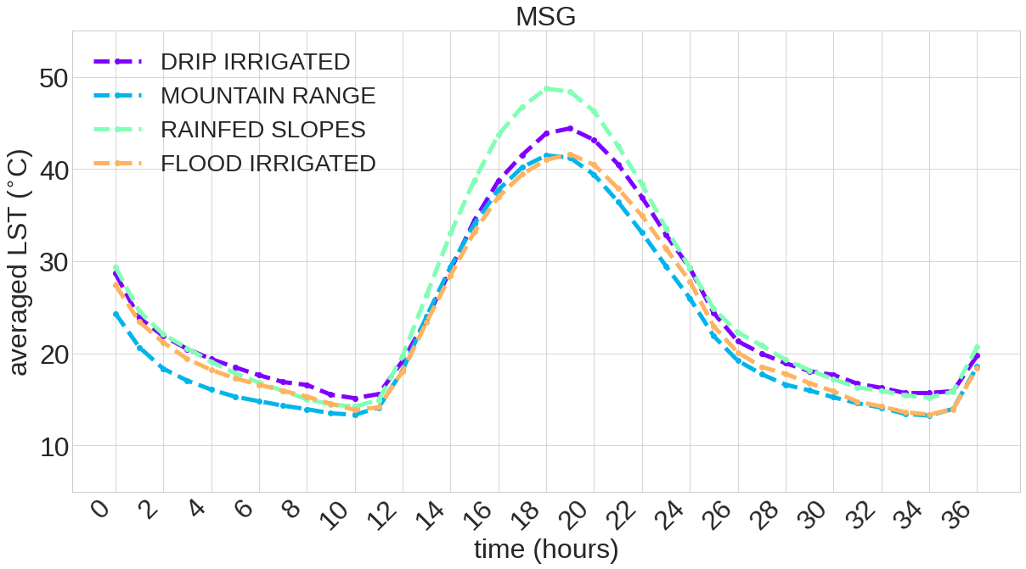
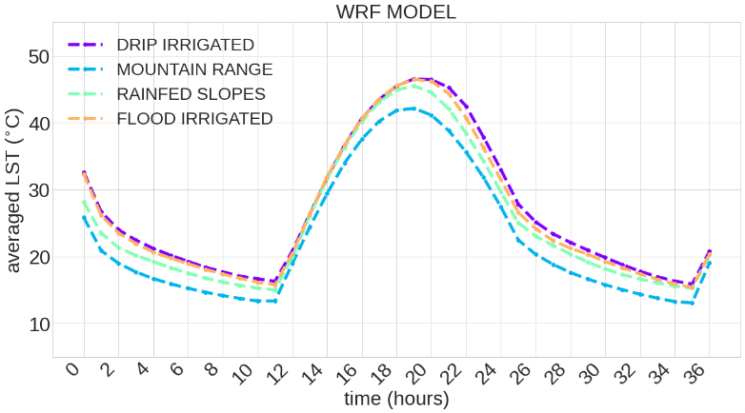
Averaged temperature over the regions
MesoNH
Spatial resolution
Soil features
Moloch
UM
Observations – MSG
WRF
Validation using LST

Slide 11
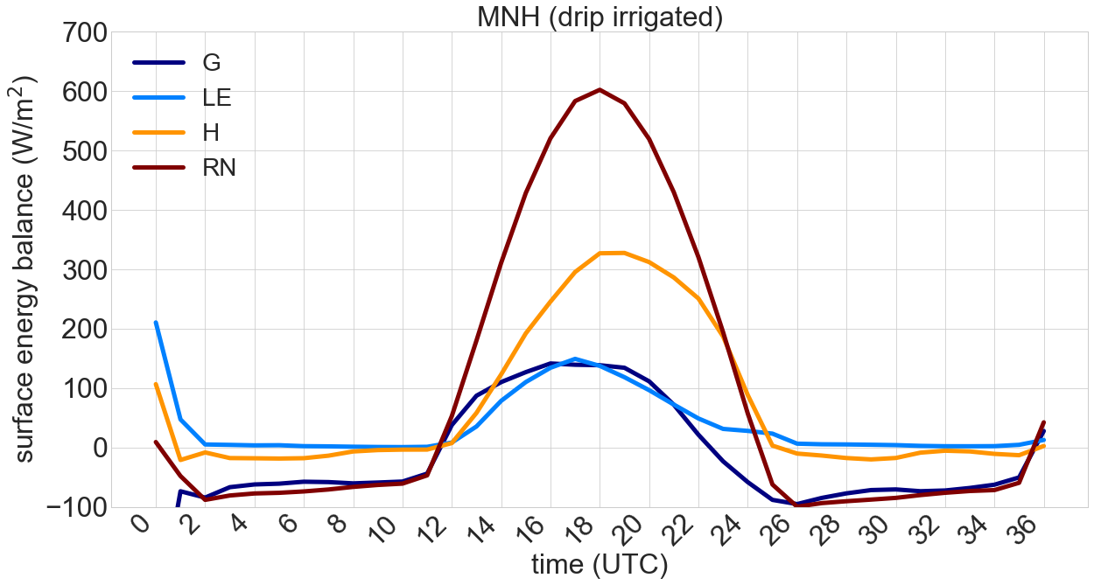
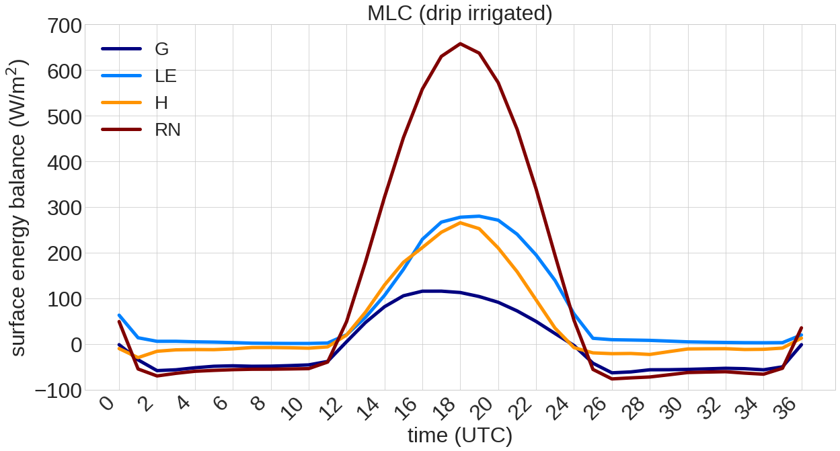
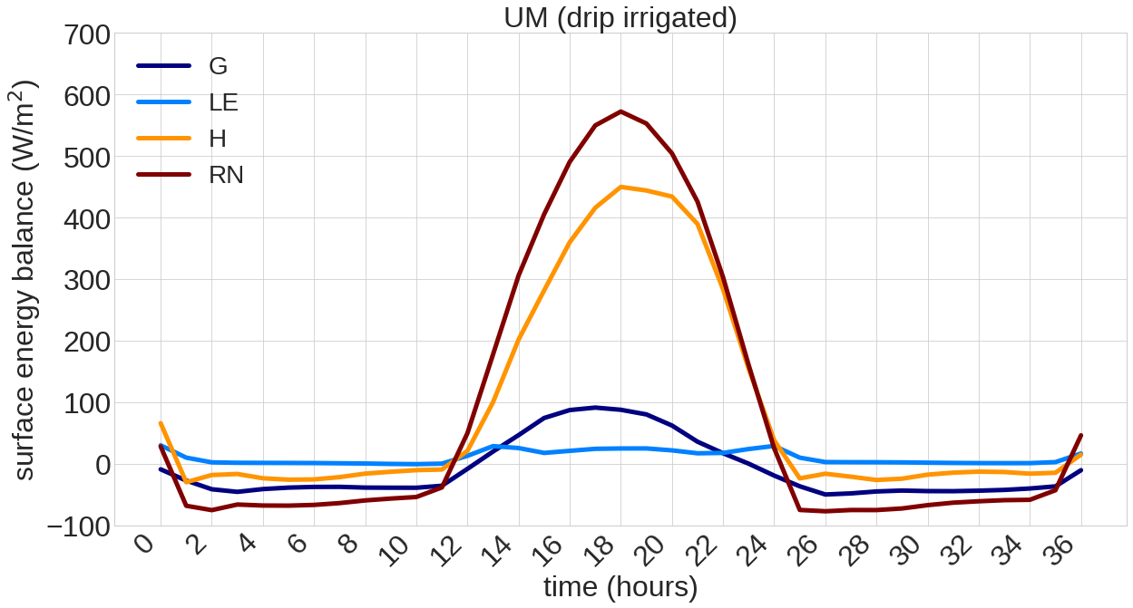
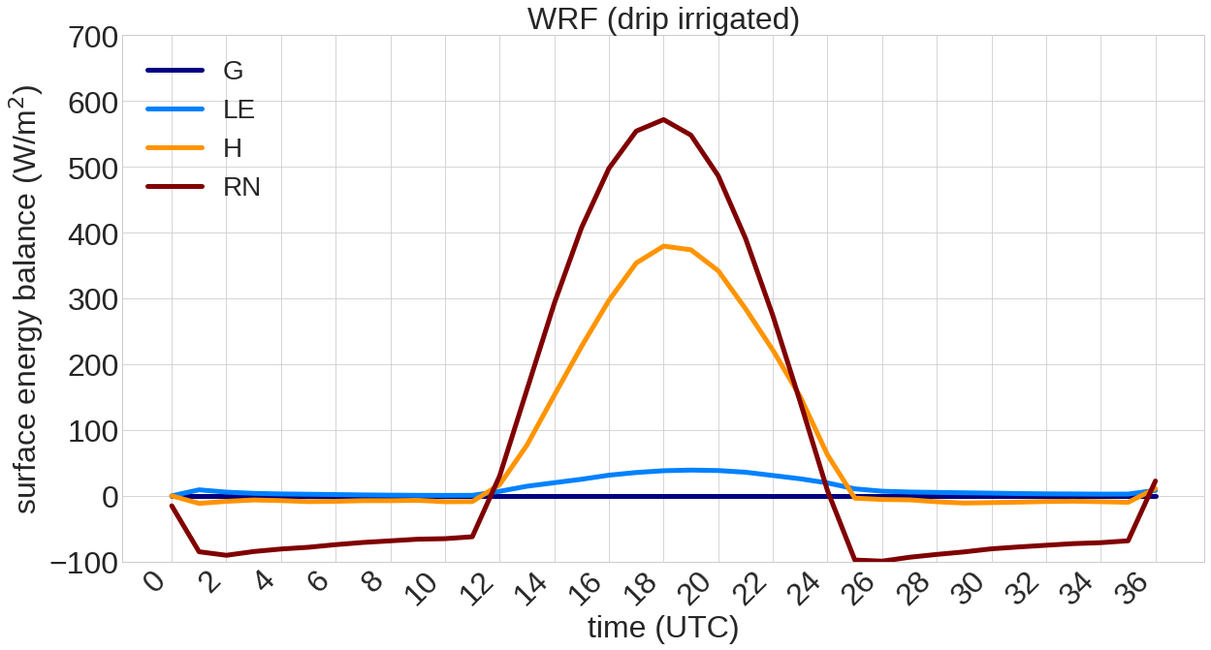
MesoNH
Variability of SEB
SEB terms averaged
for each region (drip irrigated)
All the models
do not present significant differences in the SEB terms for each region
Moloch
UM
Ground Flux
Latent Heat Flux
Sensible Heat Flux
Net Radiation
WRF

Slide 12
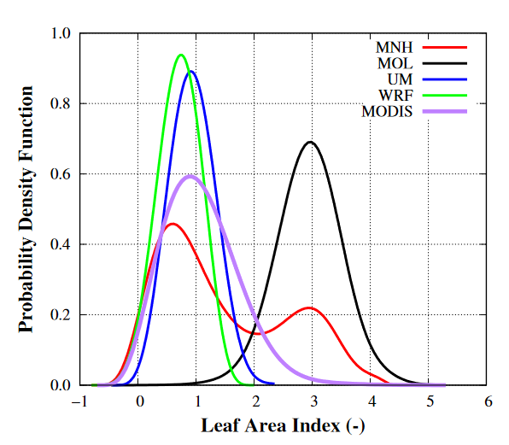
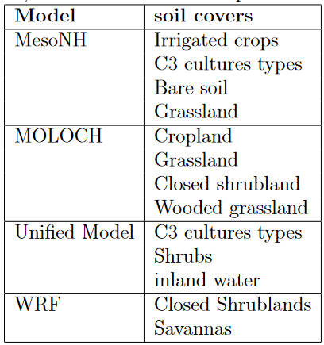
Variability of the surface cover
Models present differences in the surface parameters (LAI, fveg, albedo, ...)

Slide 13
Summary
The case 16-18 July 2016 is taken for the 1st mesoscale intercomparison.
Locally-generated circulations
(interaction between local, basin, mesoscale)
Results (known features): models are able to reproduce the general patterns of the region BUT:
Models tend to overestimate wind speed (daytime)
Difficulties in reproducing nocturnal nearly calm conditions
Temperatures are overestimated (specially during night-time)

Slide 14
Summary
Models are not able to reproduce the heterogeneities:
Surface model (processes included, irrigation)
Surface parameters & initialitation
(irrigated, rainfed,… zones)
Parameterizations (turbulence, advection, radiation)
Sensitivity tests (work in progress)
Initial and lateral BC (GFS, NCEP)
Surface features
(soil moisture, vegetation, surface model...)
Spatial resolution
After testing models + LIAISE campaign: possible future GEWEX intercomparison

Slide 15


THANKS
session 3. Remote and in situ measurements (27th May 2021)
3P4: Surface thermal heterogeneities in the eastern Ebro basin and their impact on regional circulations, Torres et al.
14h30: Land surface Interactions with the Atmosphere over the Iberian Semi-arid Environment (LIAISE) Project: Field Campaign Update, A. Boone et al.
14h45: An overview of the Analysis of Precipitation Processes in the Eastern Ebro Subbasin (WISE-PreP) Project, Joan Bech et al.

